Slide 1
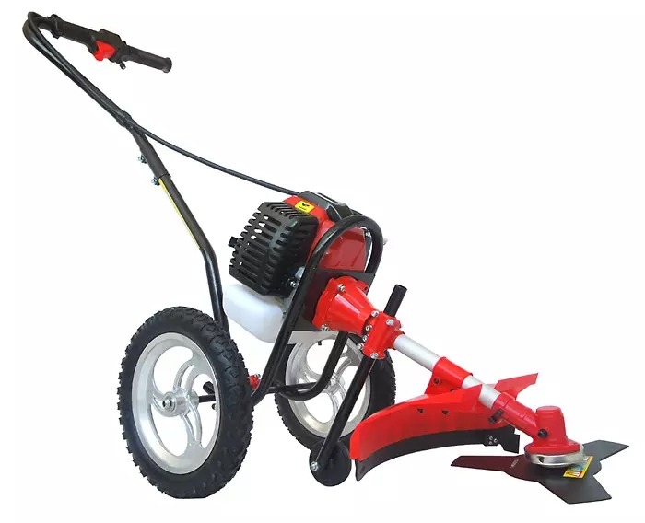
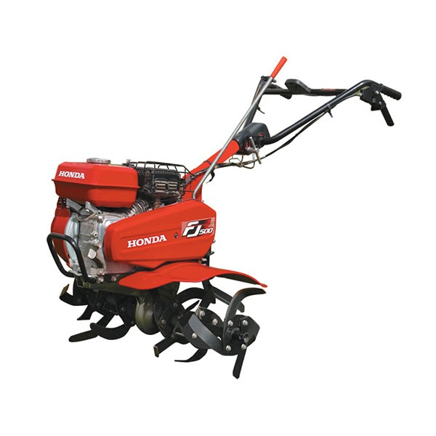
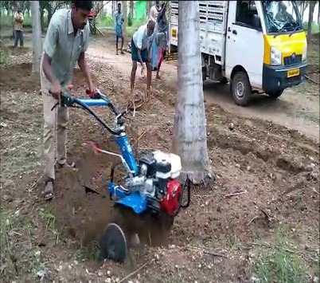
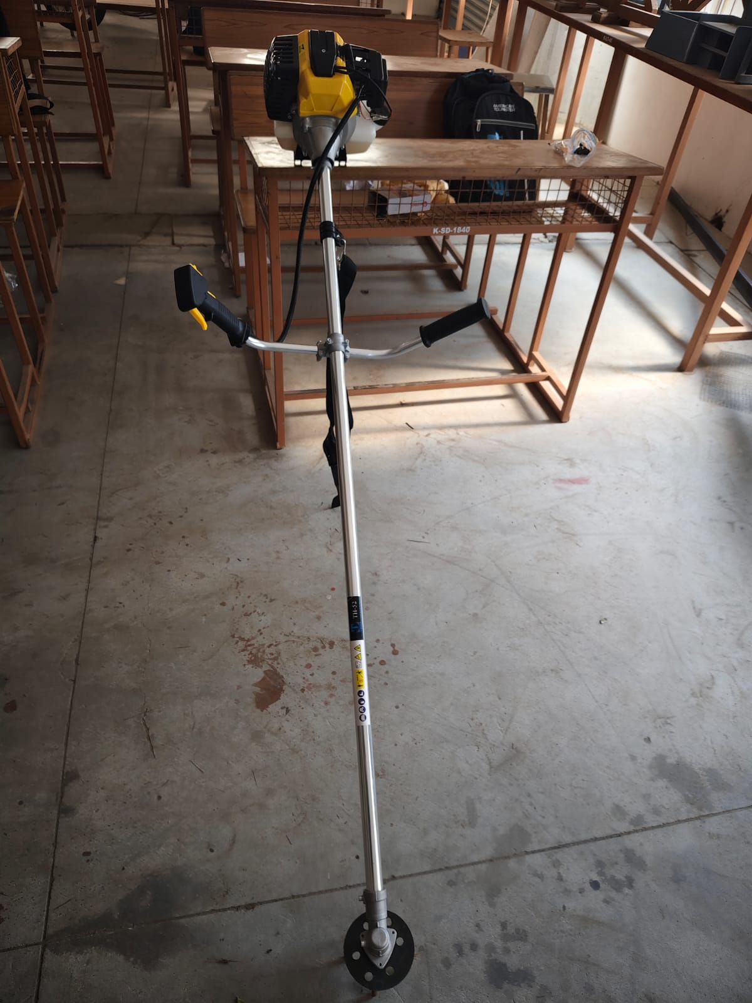
Power Weeder for Coconut Farm
Design: Wheeled Brush Cutter
Concept: Engine-driven rotary cutting system with wheels for support
Main Limitation: Bulky and less suitable for narrow spaces between coconut trees
Machine Cost: ₹8,500 to ₹18,500
Design: Rotary Tiller
Concept: Multiple rotary tines used for soil cultivation and weed removal
Main Limitation: Larger size and comparatively difficult to maneuver around individual coconut trees
Machine Cost: ₹20,000 to ₹ 50,000
Design: Mini Power Tiller
Concept: Compact engine-powered tiller for soil loosening and cultivation
Main Limitation: Requires more space for operation and is comparatively heavier
Machine Cost: ₹15,000 to ₹ 30,000
Design: Proposed Power Weeder
Concept: Portable brush-cutter-based system with a laser-cut spiked disc and replaceable bolt-type spikes
Main Limitation: Designed specifically for simple weed removal and easy maintenance
Machine Cost: ₹6,800

